Slide 1


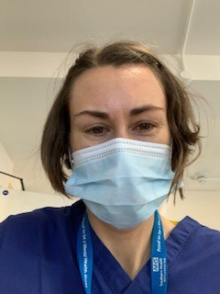

Supporting the Mental Health of Children & Young people
Emma Wadey
Deputy Director Mental Health Nursing
NHS England & Improvement
Consultant Nurse Psychiatric Liaison

Slide 2

The Mental Health Needs of children and Young people

Slide 3
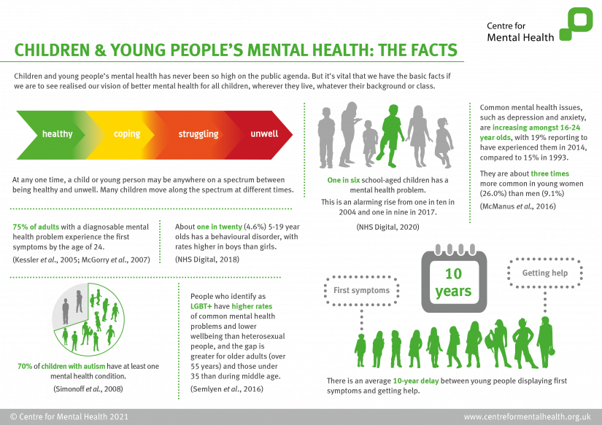

Slide 4
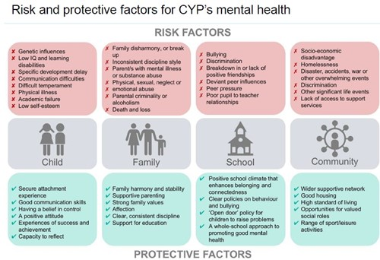

Slide 5
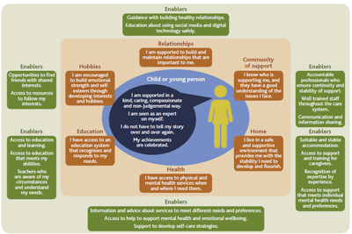

Slide 6


Slide 8
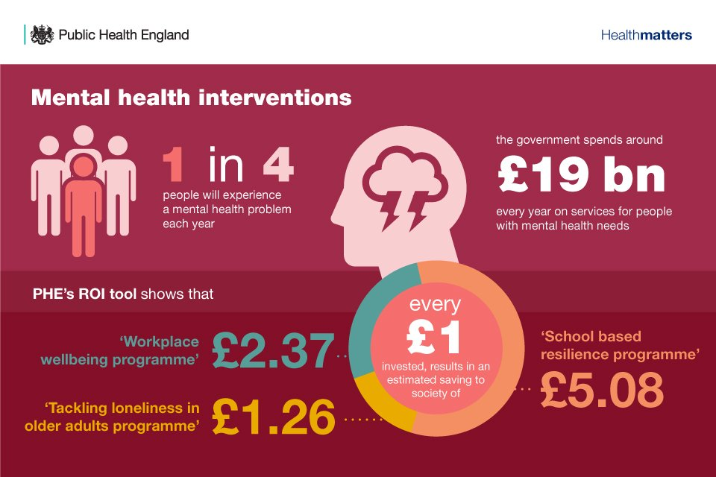

Slide 9
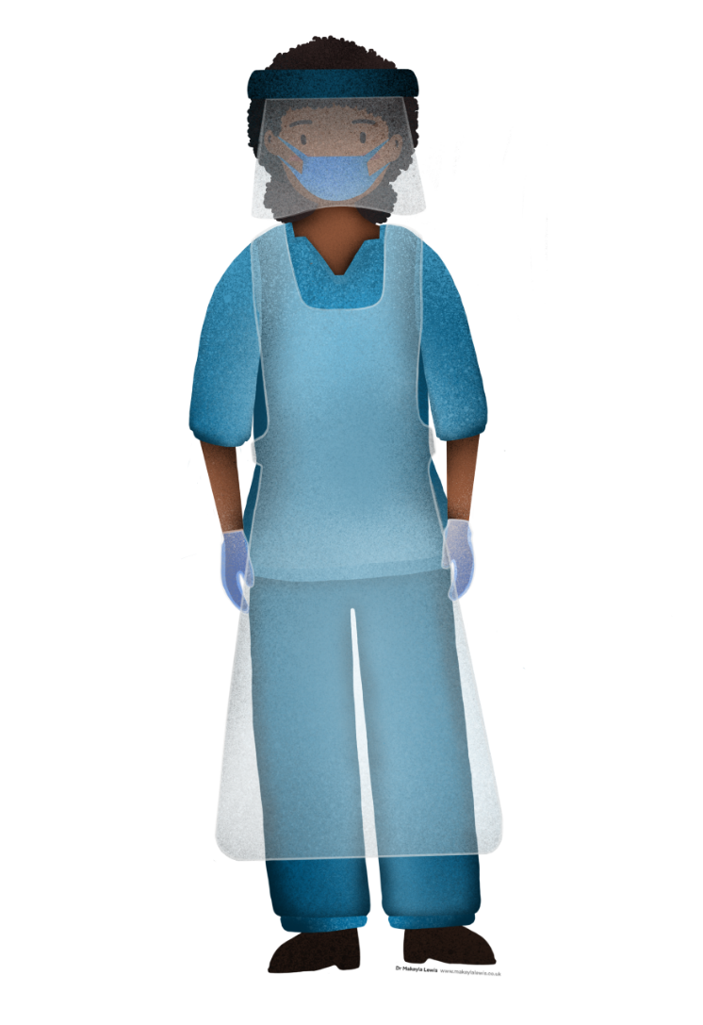
Mental Health Needs of the Nursing Workforce

Slide 10
Latest data from research studies suggesting increased prevalence of mental health need amongst frontline staff
Prevalence of mental illness appears higher in NHS staff when compared to the general population
Key findings from academic research
This data requires further analysis and interpretation , e.g. noting that participation in surveys skewed to those with more negative experiences, but is indicative of need for action.
Correlates with international evidence : Frontline health care workers engaged in direct diagnosis, treatment, and care of patients with COVID-19 in China were associated with a higher risk of symptoms of depression (Lai et al. 2020)
Up to half of HCWs (49.4%) will experience significant acute mental health symptoms during a pandemic, with more than one in ten having ongoing mental health consequences (Harvey et al. 2020)
Kevin Fong’s study on critical care staff shows elevated levels of need for staff in those settings.
However, it is line managers, peers and teams who can provide best level of support for each other, and “resilience resides in teams”. This is focus of People Directorate HWB plan and actions in train.
It is key not to over-medicalise the response, but to ensure rapid access to evidence based treatment is there for staff who need it.
AHSN survey
NHSE/I commissioned
Mental Health in the UK
DRAFT analysis: requires further interpretation
PTSD
Anxiety
Depression
24.31%
38.32%
37.51%
4.4%
25.2%
31%
General population
NHS staff
Mental Health UK Study – N=3097(UK Public) – C19 UK Public Survey N=53,328 (UK Public)
NHS Check N = 10,281 (NHS Staff) – NHS Trauma Group -N = 1,211 (NHS & Social Care Staff)

Slide 11

A range of support is needed and available
From staff member feeling distressed
To needing specialist mental health intervention
Self help
Need to talk
More intensive
support
Mental Health intervention
Crisis
Access to apps:
Umind
Headspace
Stayalive
Daylight
Sleepio
Cityparents
Yoga platform
Brightsky
Liberate mindfulness
Digital resources:
People.nhs.uk website
Silvercloud for mental well health self-guided tools
Support from family, friends & community
Line manager discussion
Team support conversations
Local Peer supporter
Freedom to Speak up guardians
Occupational Health and EAP support
NHS Helpline
NHS Text line
NHS Bereavement helpline
Tagalog speaking helpline
Financial support helpline
Common rooms –
Groups of staff coming together around critical issues
Project5 – 1-1
support and coaching
Ass. Clin Psy – for
Senior staff, access 6 sessions of Psychologist time free
Access our
screening website and answer mental health questions to help understand next steps
Self refer to IAPT/local Psychological services
Mental health & Wellbeing hubs- Wave 1 being established - who can outreach, assess, and support rapid access to evidence based NHS treatment
Brief interventions from EAP services
NHS Urgent mental health helplines , available 24/7 across the country will provide a confidential service for staff.
https://www.nhs.uk/service-search/mental-health/find-an-urgent-mental-health-helpline
Local, System and Regional support

Slide 12

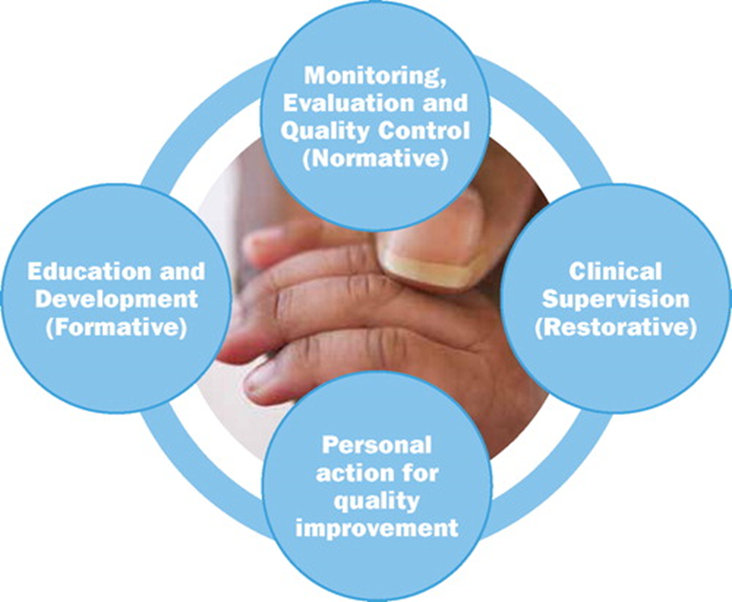

Professional Nurse Advocates The A-EQUIP Model
The A-EQUIP model is made up of four distinct functions: restorative, personal action for quality improvement, education and development; and monitoring, evaluation and quality control
Restorative clinical supervision
Personal action for quality improvement
The model aims to support the nurse through a process of restorative clinical supervision, personal action for quality improvement and preparedness for professional revalidation
The deployment of the model supports a continuous improvement process that builds personal and professional resilience, enhances quality of care and supports preparedness for appraisal and professional revalidation
Education & Development
The ultimate aim of using the A-EQUIP model is that through staff empowerment and development, action to improve quality of care becomes an intrinsic part of everyone’s job, every day in all parts of the system.
www.england.nhs.uk

Slide 13
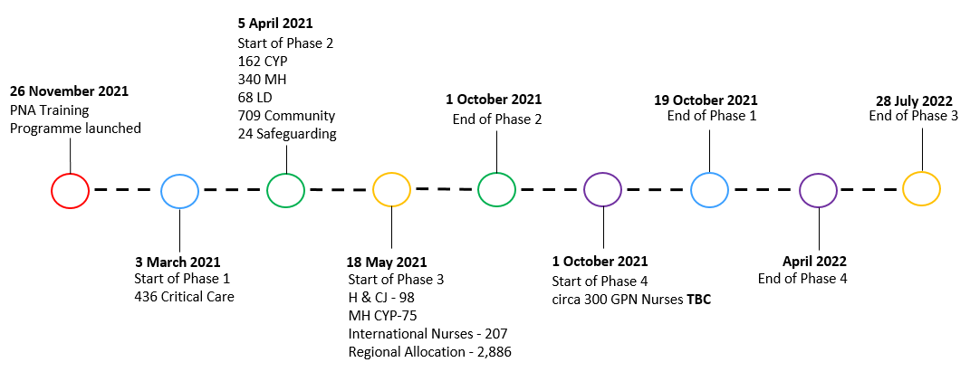
PNA Roadmap and Allocation Across England
Phase 1
436
Critical Care
Phase 2
162
Children and Young People
340
Mental Health
Phase 3
98
Health and Criminal Justice
75
Children and Young People Mental Health
68
Learning Disabilities
709
Community
207
International Nurses
24
Safeguarding
2,886
Regional Allocation
Phase 4
GPN Nurses TBC
Total Number of PNAs completed training 1,629
Total Number of PNAs in training 1,130
Total Number of PNAs waiting to start 135
Total PNA places awaiting allocation 2,411
Total 5,305
NHS England and NHS Improvement

Slide 14
Key Points
There is no health without Mental health
Prevention is better than cure
COVID- 19 Pandemic has had a huge impact on all of our lives
Need to work together in partnership
To meet the needs of children, young people and their families Nurses need to take care of themselves
self-care = excellent patient care

Slide 15
Thank you
Emma.wadey@nhs.net
@nursingemma

