Slide 1
Roald Dahl’s Marvellous Children’s Charity
Nurses Leadership Programme
Lisa Cutsey
Roald Dahl Neuromuscular Transition Nurse Specialist
Roald Dahl Nurse Specialist Conference 2021

Slide 2
Leadership-Establishing the right team!

Slide 3
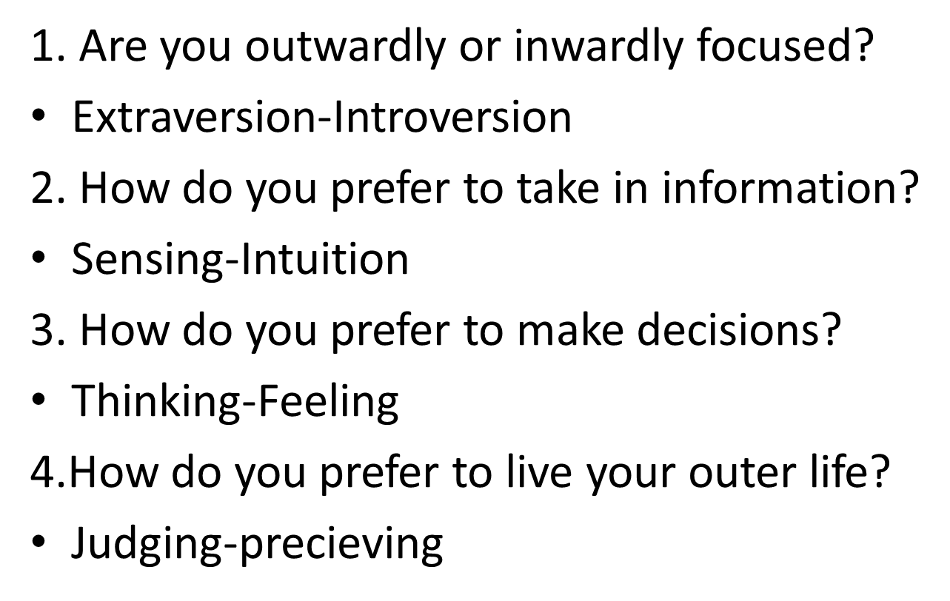
Change in individual practice:
• Awareness of my own personality type how this can affect others in a team. Building a team that consists of varying personality types working to the strengths of all of those in the team. Taking time to reflect and sit back before acting!

Slide 4
Royal Academy of Dramatic Arts(RADA) Workshops

Slide 5
Co-Consulting: Active listening
Listening for needs
Listening for cues
Listening for understanding

Slide 6
Co-consulting: Good questioning
Good questioning enables
Foster commitment
Encourage exploration
Elicit new ideas
Focus attention

Slide 7
Quality Improvement Project: Improve peer support and wellbeing of young adults with myasthenia gravis aged 12– 16 years old.
Leadership learning
Plan, do, act methodology was activated by identifying our project methodology of an experienced based co-design
Definitive set stages facilitated the process making success less daunting. Allowed us to develop a comprehensive project initiation document to set clear criteria and timelines
Set parameters on how to capture qualitative data on effective change improvements
Clear template to follow when initiating project to adult services
Client, consultant, observer workshops and the cycle of action learning enhanced interactions with young people to help identify ways and reasons of how to best serve our client population

