Slide 1
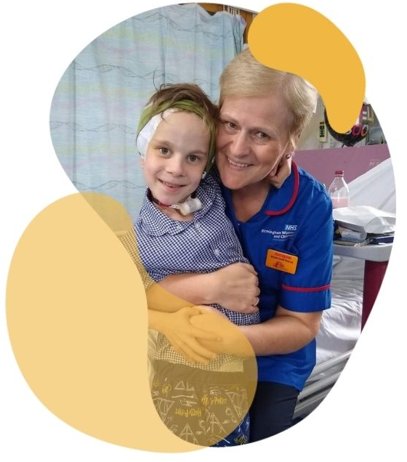
Roald Dahl’s Marvellous Children’s Charity
Strategy and Plans
30 years of providing specialist nurses
and support for seriously ill children

Slide 2
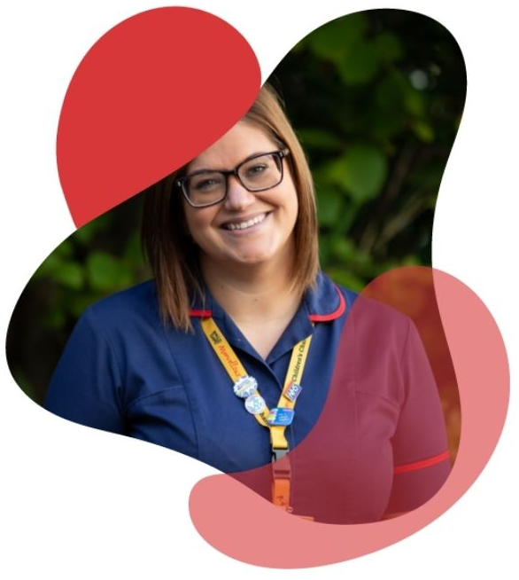
We believe every seriously ill child should have a Roald Dahl Nurse
Roald Dahl’s Marvellous Children’s Charity provides specialist nurses and support for seriously ill children living with complex, lifelong conditions.

Slide 3
Key Strategic Charitable Aim
To improve the healthcare outcomes and resilience of seriously ill children and their families living with complex, lifelong, and under-funded conditions.
Outcomes:
Improved quality of care
Improved experience of care
Improved efficiency and cost-effectiveness in care
Improved resilience of seriously ill children and their families

Slide 4
Charitable Programmes Focus #1
Create further Roald Dahl Specialist Nurse posts in partnership with the NHS:
New posts in 2021-2022 and 2022-2023
Broadening the Roald Dahl Nurses Community

Slide 5
Charitable Programmes Focus #2
Developing, providing and supporting children’s specialist nurses as leaders in the sector:
Group training and development e.g. mental health (February 2022)
Educational grants (for individual training)
Platforms for sharing best practice and experiences e.g. Facebook Workplace
Coming together e.g. Roald Dahl Nurses Conference
Providing other leadership training opportunities e.g. Florence Nightingale Foundation Leadership Course

Slide 6
Charitable Programmes Focus #3
Championing specialist nurse-led innovation in children’s healthcare
Inventing Room programme: currently in ideas generation stage
Development for the future

Slide 7
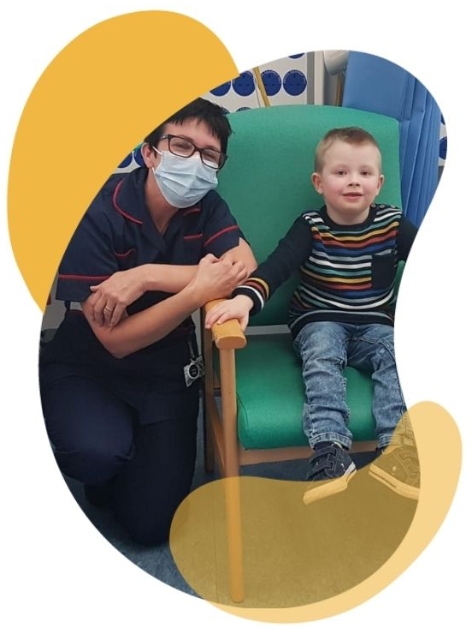
Charitable Programmes Focus #4
Providing additional support to seriously ill children and their families:
Roald Dahl Family Support Service launched in April 2021
1 year pilot working with Citizens Advice Cardiff and Vale to unlock benefits for our Roald Dahl families
To date over £37kvalue in benefits have been enabled

Slide 8
Impact Measurement/ Programme Evaluation
Tools to support and improve our work to meet the outcomes of our framework:
Project: Sheffield Hallam Study
Ongoing: Nurses Audit

Slide 9
Coming up
New Roald Dahl Nurses
Affiliate & alumni programmes
New training programmes
New partnerships
Further research into the impact we can make from 2023 onwards

Slide 10
The Charity & You
Our priority is to deliver the work we do and support our nurses – how can we do this better?
What would help you care better for your children and their families?
How you can help us (Best kept secret)
Together we can help thousands more seriously ill children

Slide 11
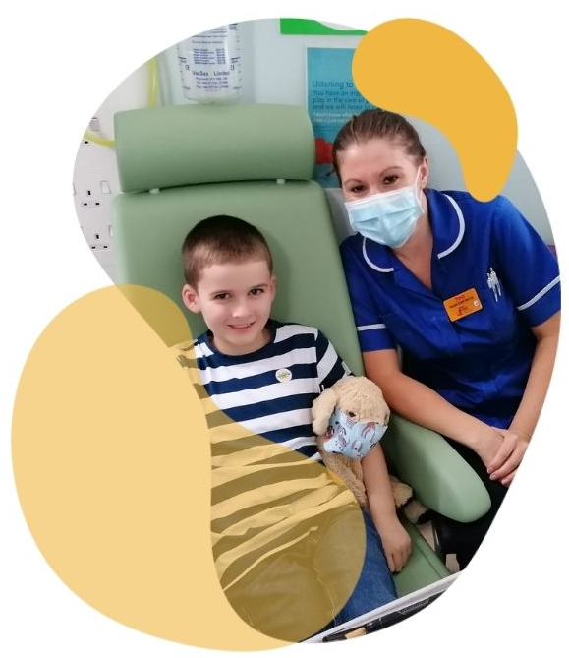
Thank you for listening!
30 years of providing specialist nurses and support for seriously ill children
Sub heading

