Slide 1
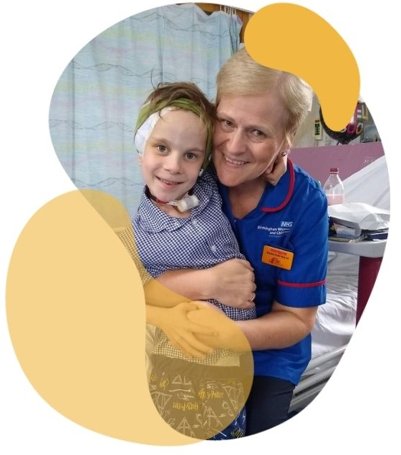
Why is the role of a specialist nurse so important to children with serious lifelong illnesses?
Professor Sally Shearer OBE
Executive Director of Nursing and Quality, Sheffield Children’s NHS FT
Visiting Professor, Sheffield Hallam University
Chair of the Association of Chief Children’s Nurses
Twitter @Sally_Shearer

Slide 2
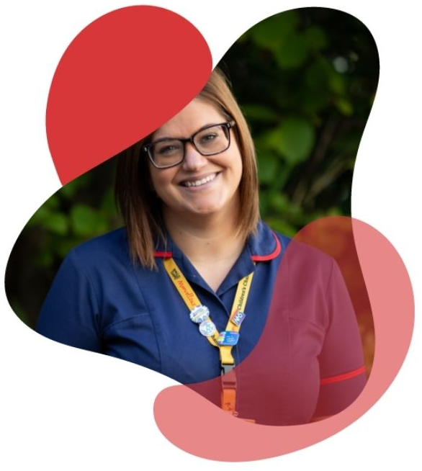
Children and Young People with Serious Lifelong Illness
12 million children live in England, 28% with long term conditions = 3.36 million children
Four categories of community care for nursing CYP
• Children with acute and short-term conditions.
• Children with long-term conditions.
• Children with disabilities and complex conditions, including
those requiring continuing care and neonates.
• Children with life-limiting and life-threatening illness, including
those requiring palliative and end-of-life care.

Slide 3
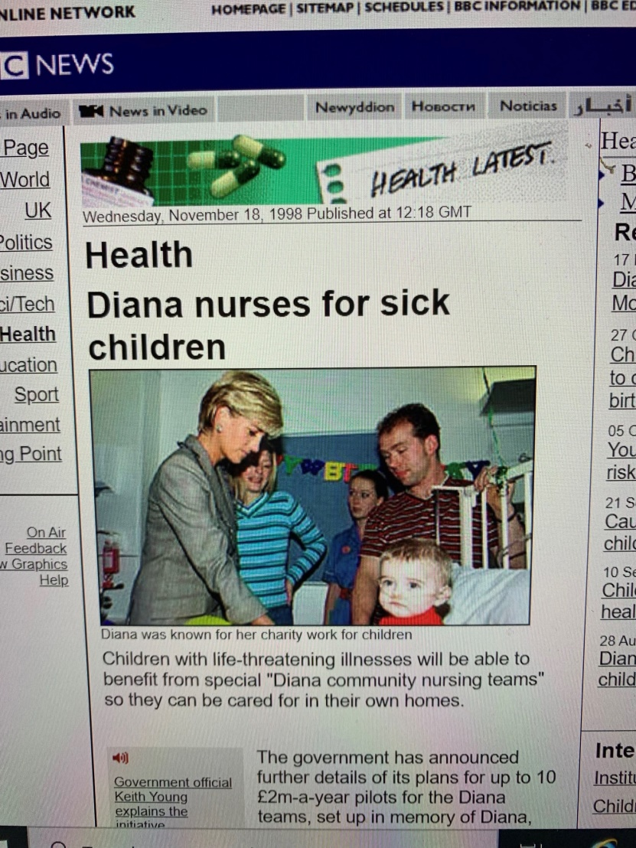
Diana Nurses for sick children 18th November 1998
specialist care and advice
practical assistance in the home to help families cope with the demands of caring
some equipment for the home and transport
emotional, psychological and spiritual support

Slide 4
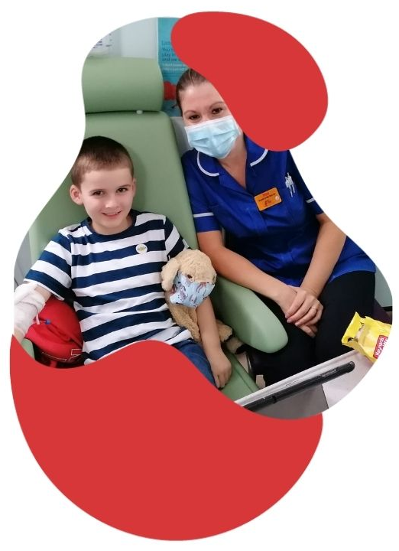
Specialist nursing in 2021
Reducing patient waits
Creating capacity with digital solutions
Reducing ED presentations and admissions
Preventing delayed discharges
Supporting rehabilitation
Reducing length of stay
Releasing inpatient capacity

Slide 6
Influences on child health
Household income
Education
Housing
Stable and loving family life
Healthy environment
Difficult mental health
Poorer educational outcomes
Inequality
Vulnerability
poverty
Challenging family and social circumstances
Complexity .

Slide 7
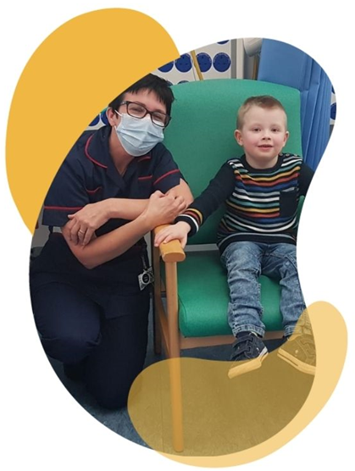
Specialist nurses ….
Understand patient pathways
Have established networks and relationships
Know their families and build trust
Build confidence
Are there at all life stages
Solve problems

Slide 8
Super connectors @helenbevan
Unknown to ‘formal leaders’
Go to people, with relationships and connections
Trusted at ground level
Bring people together
Work interdependently not independently

Slide 9
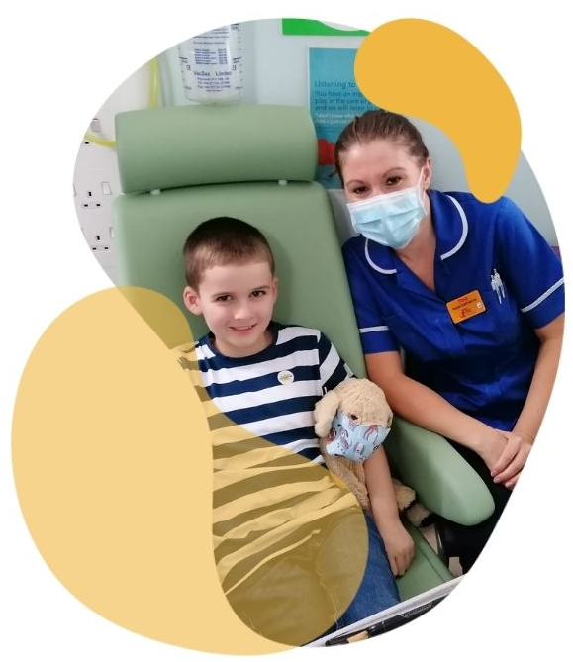
Integration of services within health and care
‘’local areas designing and implementing models of care that are age appropriate, closer to home and bring together physical and mental health services. These models will support health development by providing holistic care across local authority and NHS services, including primary care, community services, speech and language therapy, school nursing, oral health, acute and specialised services”

